Slide 1
Simple Password Generator By Java
Here is where our presentation begins

Slide 2
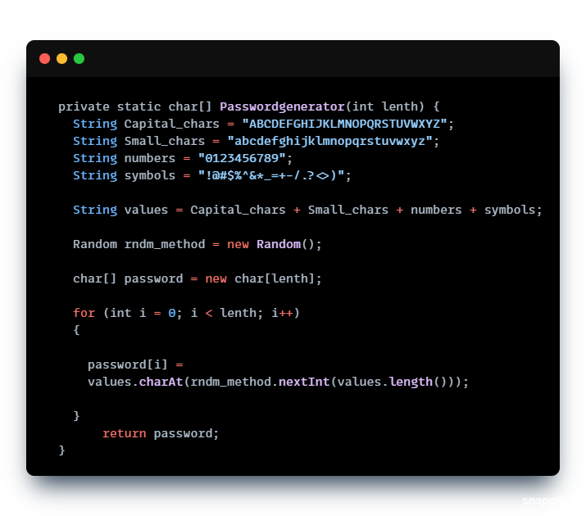
About this Password Generator
Here with java we have created a simple Password Generation where user can input their password generation length and the system returns a unique password with Capital, Small, Number and Symbols.
Let’s See our Code:
So Firstly, here we can see, we have taken String Data Type and Variables of Capital_chars, Small_chars etc etc and Defined what are these.
Secondly we have taken a object called values and added the Data Typed Variables here
Thirdly with Random(); function on java library we run a Random method.
Then took char[] and declared character length to process password into definite length.
Then we took for loop to generate the password within the given length
It returns password

Slide 3
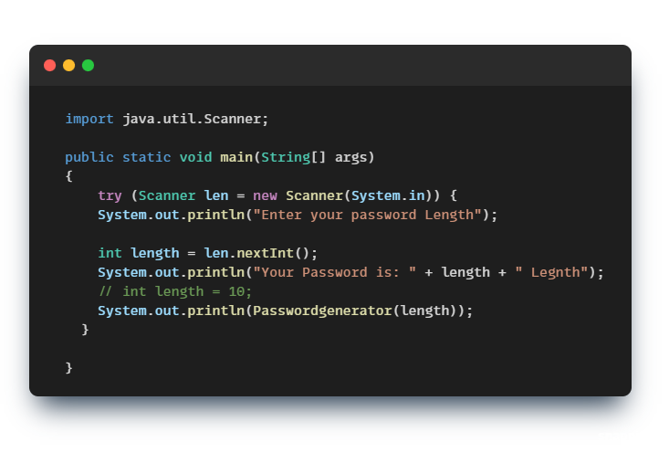
The Main Method
Here we see how our main method works on java.
In Java we write public static void main(String[] args) as main function or method on Java
Let’s See our Code:
Here in main function we had to take a library called java.util.Scanner; which takes input on terminal
In public static void main(String[] args) We have declared try method to close the functions
Took Scanner len as a object for scanner then the ‘’Enter you password Length is just a display to show user to enter length for password.
Took int length which is equal to len.nextInt(); which directs us to length taken in integer
Then We print our password and desired password length on our terminal.

Slide 4
Thank you
With this main method we complete our code / script of Simple Password Generation on java.
Presentation and Project for Data Structure
Submission Sir Al Akram Chowdhury
LECTURER
Department of BSc in Software Engineering.
Metropolitan University, Sylhet
Coded by Shafat Alam – SE 1st Batch
Presentation Created by Shafat Alam – SE 1st Batch

